Slide 1
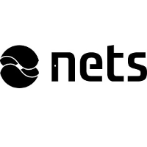

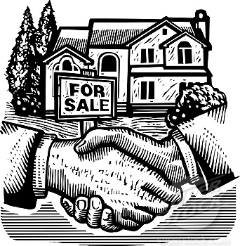
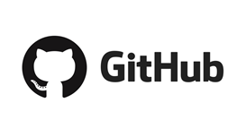
A secure marketplace for asset transactions on the Ethereum blockchain
secure marketplace for asset management
https://github.com/benedikt-kirpes/nets-case

Slide 2

Current Process
Inefficient
Non-transparent
Loss of control
To create a secure marketplace for asset management
Notes:
Create a marketplace for asset management including the buying and selling of assets, securing funding, and verification by a separate, trusted entity
For this case study, we are exclusively focusing on real estate..

Slide 3
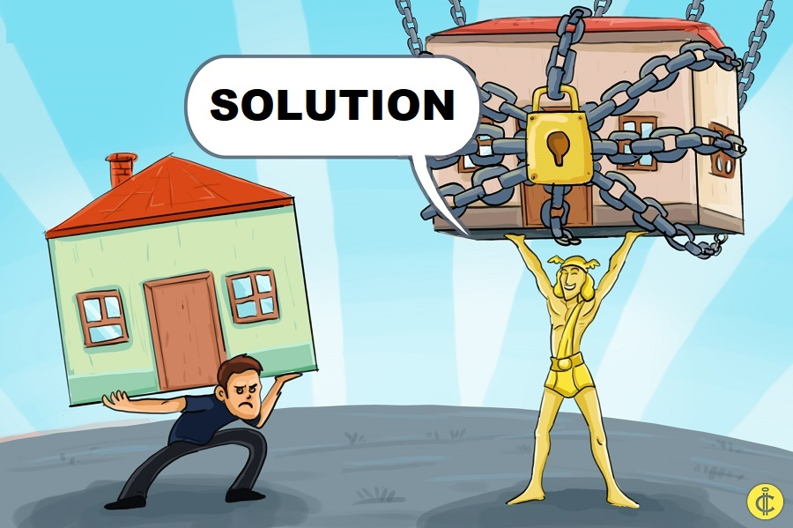
Tamper-proof land registry
Secure ESCROW with atomic transactions
Notarizing inspection data
Decentralized marketplace

Slide 4
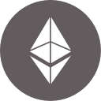
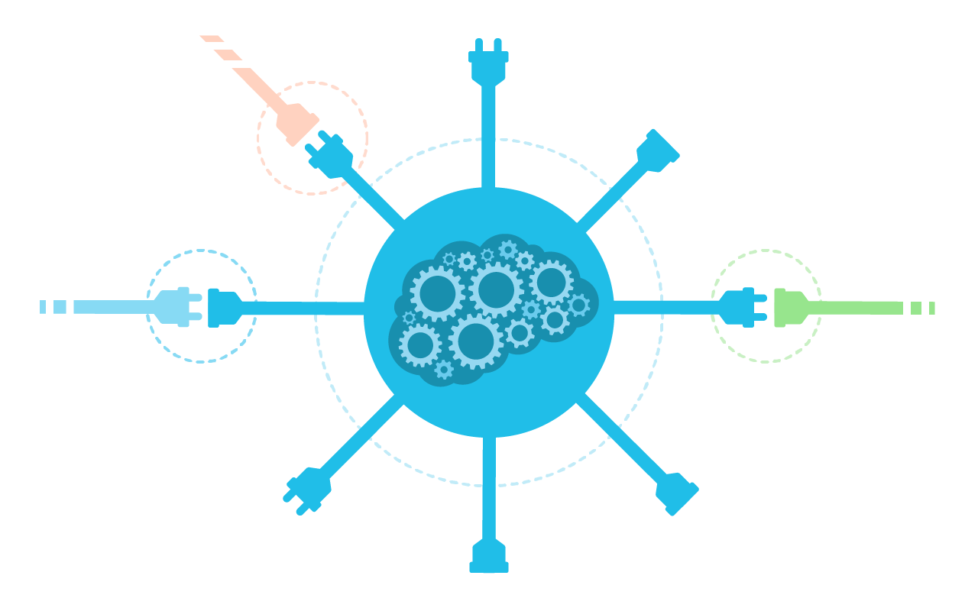
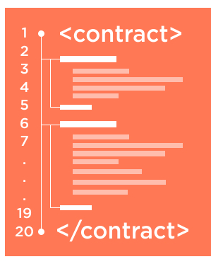

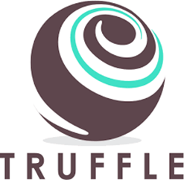
DApp Elements
www.
web3
Notes:
The Truffle framework deploys our Smart Contract in the Ethereum Blockchain and connect it with our WebApp using the Web3.js API
The Truffle framework deploys our Smart Contract in the Ethereum Blockchain and connect it with our WebApp using the Web3.js API

Slide 5
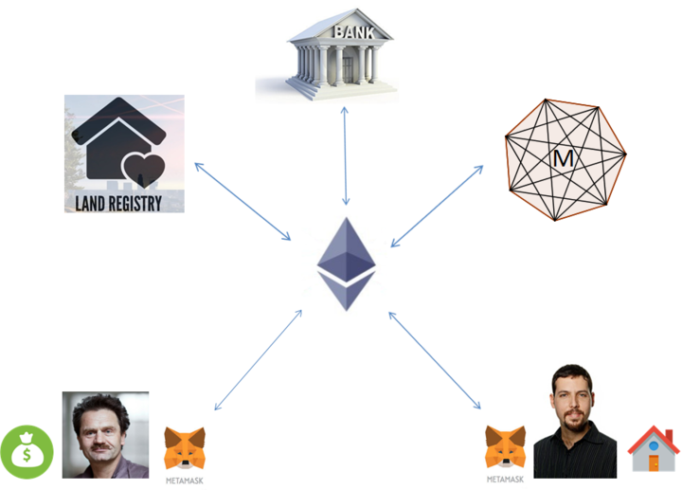
Actors in the
Decentralized Marketplace
Buyer
Seller / Owner

Slide 6
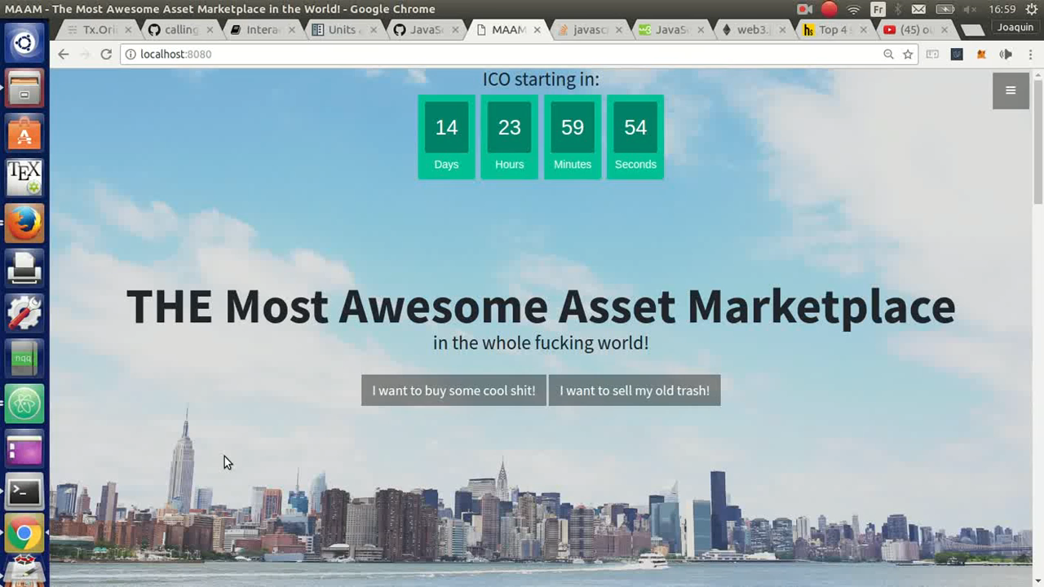

Slide 7

Next steps
Bank loan
Negotiation phase
On the fly smart-contracts
3rd party property inspection

Slide 8
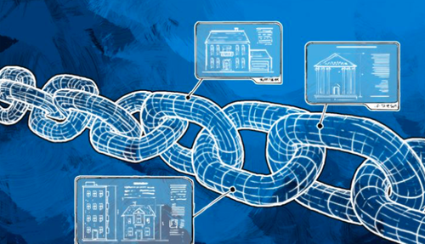
Thank you for your attention!
Benedikt Kirpes
Desmond Spreeuwenburg
Joaquin Fernandez-Tapia
Lasse Orda
Nils Neidhardt
Otto Piramuthu
Venkata Maruti Sesha Giri Marella

Slide 9
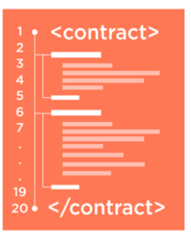







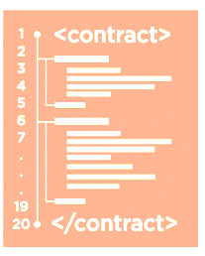
Backup slide - Architecture
Initial Entry
Owner Verification
Owner/Seller
Asset Registry
(Government)
Confirm Ownership
Bank
Asset Transfer
Buyer
Bank Loan

